Slide 1

Exploratory Data Analysis
<G2M insight for Cab Investment firm>
<August 20th, 2023>

Slide 2

Background - G2M Cab Industry
XYZ is a private firm in US. Due to remarkable growth in the Cab Industry in last few years and multiple key players in the market, it is planning for an investment in Cab industry
Give a clear view of of which company is worth investing.
The steps taken to analyze data
Understanding Data.
Finding Common Patterns.
Finding profitable Cab Company.
Choosing which company to Invest.

Slide 3
Data Analyses
Timeframe of the data: 01/31/16 - 12/31/18
17 Features
Assumptions:
There would be some cities that have a the least use for a cab company and would not be profitable.
We would calculate profit based on the Price_Charged-Cost_of_trip.
We will look the use of Cabs in each major city.
Cab_Data.csv
Customer_ID.csv
Transaction_ID.csv
City.csv
Final cab data

Slide 4
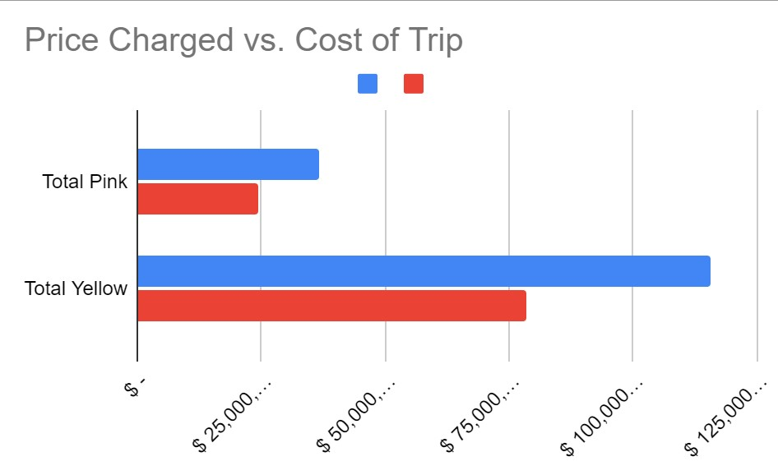
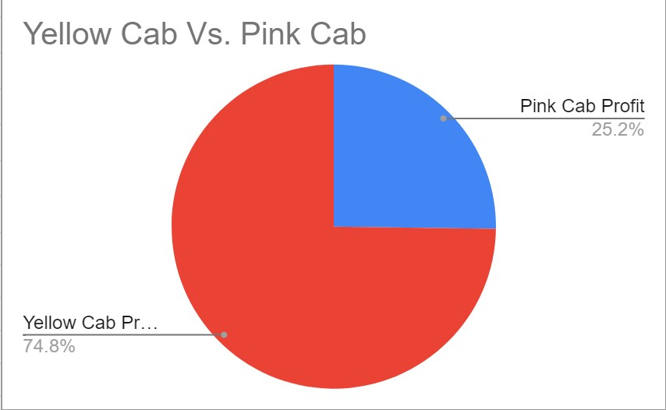
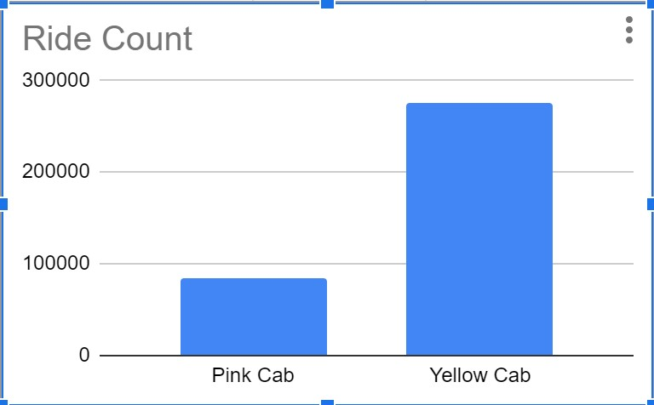
Profit Analysis (for each company)

Slide 5
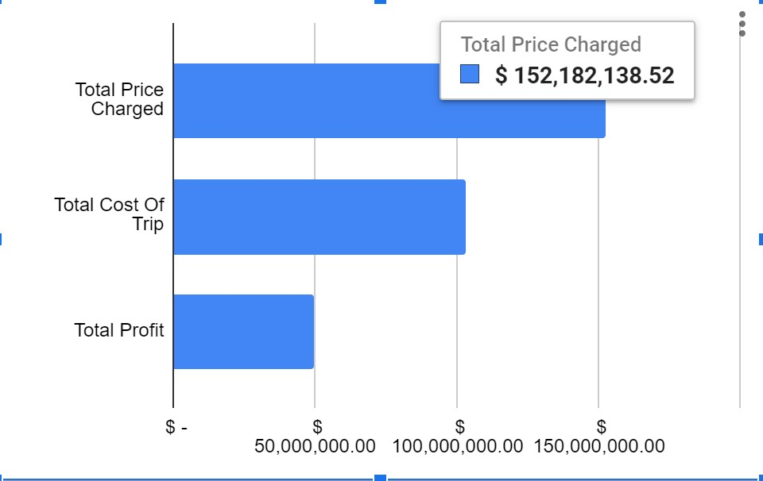
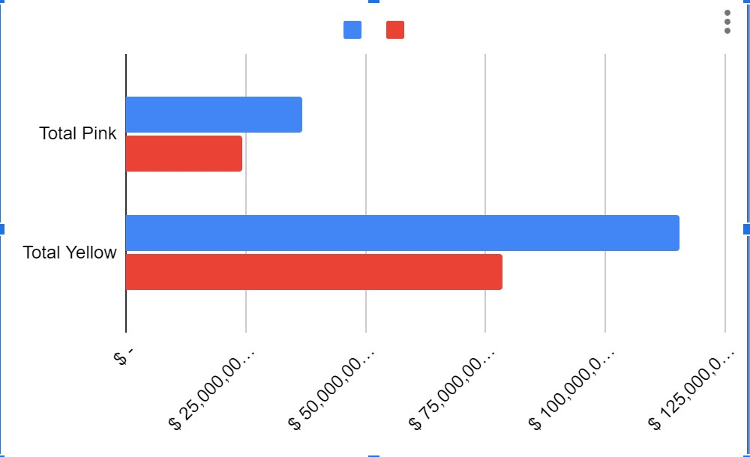
Profit Analysis (Annually)

Slide 6
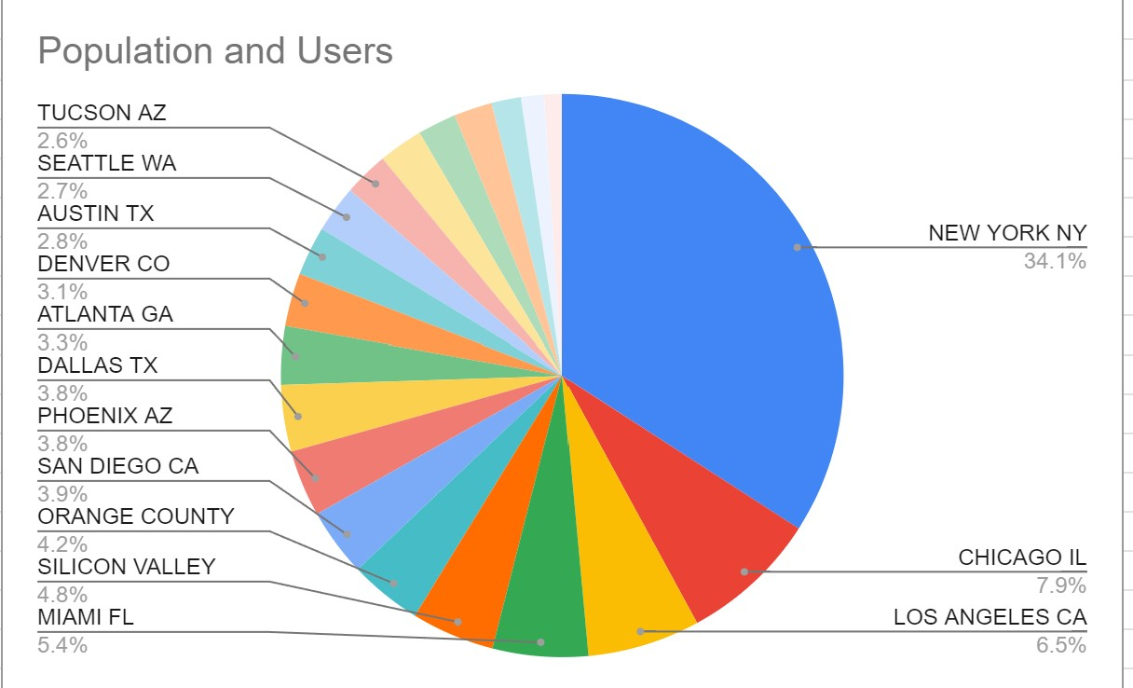
Profit Analysis (City Basis)

Slide 7
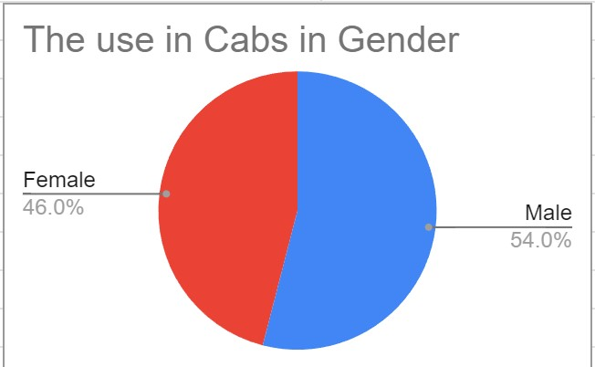
Profit Analysis (Gender Group)
The Gap is not much; however, there seems to be a bigger percentage in male users than female.

Slide 8
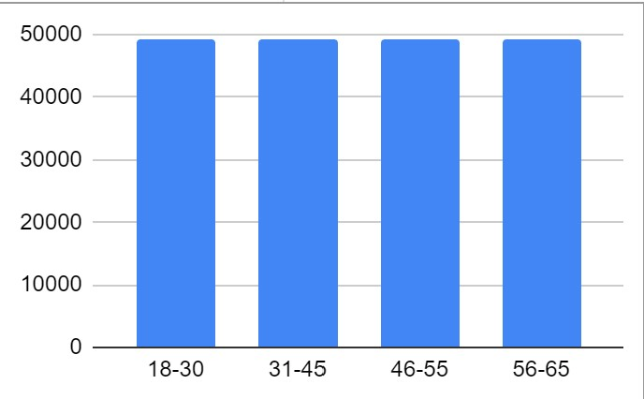
Profit Analysis (Age Group)
For the Age group there isn’t a much change since they are all around the same percent.

Slide 9
Recommendation
I strongly believe that it is important to consider the following factors:
The age group does not affect the profits for either side due to a percentage that is very similar for the four age groups
Yellow Cabs are mostly used more in general.
Some of the data corresponds to the factor of having great areas in different cities and most of them low compared to a few cities.
The use in both Genders differs by 4.00%
Conclusion:
The Yellow Cab company is the most profitable company based on the give data.

Slide 10
Thank You

